Slide 1

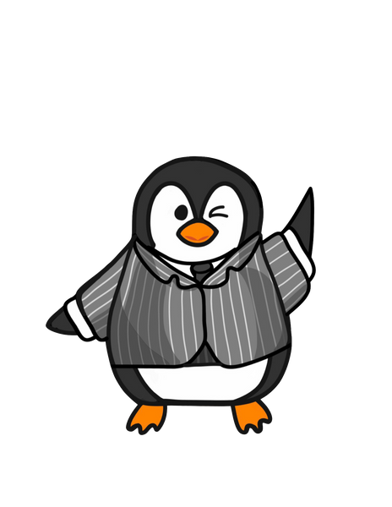
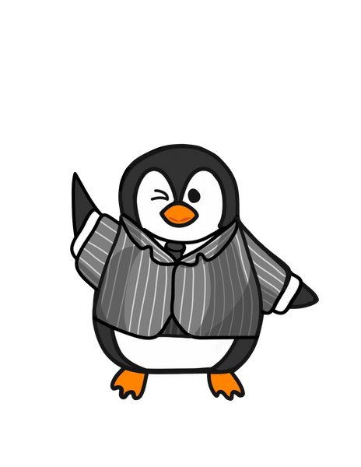

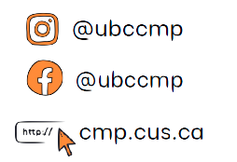

COMMERCE MENTORSHIP PROGRAM
FINAL REVIEW SESSION
COMM 393
Prepared by: Tommy Zhang
Instructed by: Tommy Zhang
Emails: tommyzhang0000@gmail.com

Slide 2
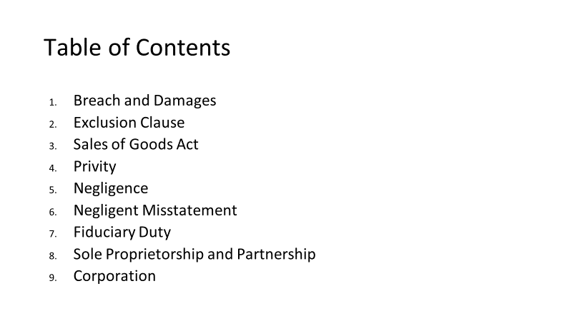

Slide 3
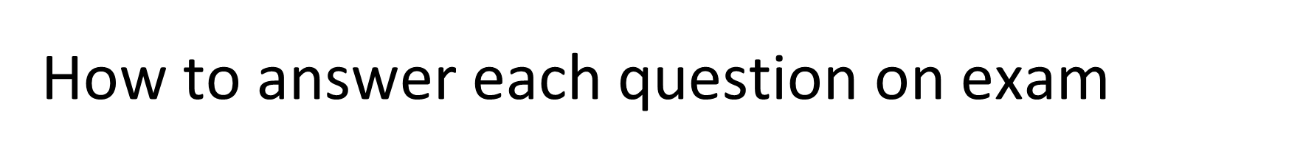
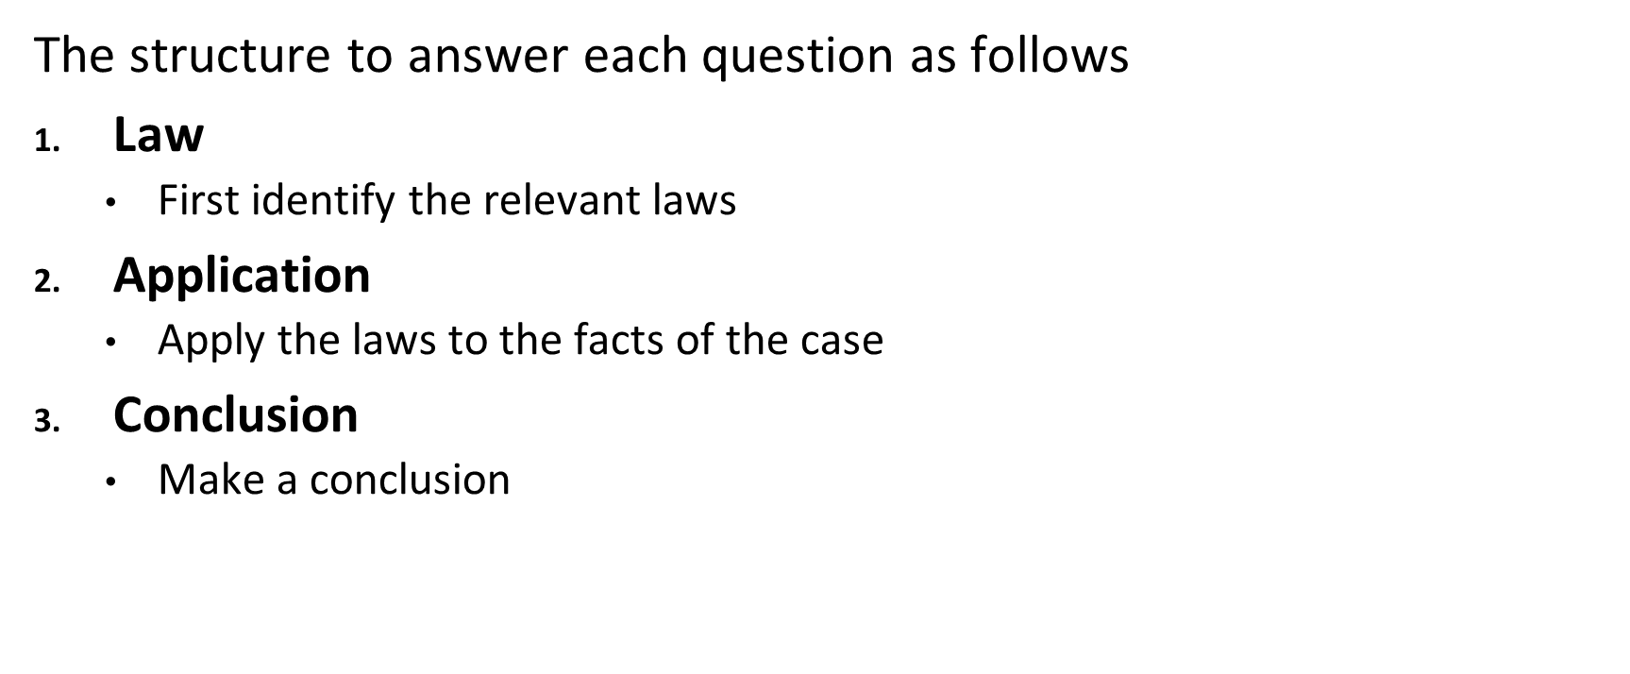

Slide 4
Question (Breach + Damages)
John owns a restaurant and has hired Jim, a professional cleaner, to clean his kitchen before yearly health inspections to avoid fines. The contract signed between the two parties stipulates that "Jim must perform the cleaning services a week before yearly health inspections.”
This year, Jim had been sick the week prior to the inspection and forgot to inform John that he cannot clean his kitchen. At the time of the inspection, John was out of town and trusted that JIm would have cleaned his kitchen based on their contract.
Two days after the inspection, John received a letter from the Canadian Food Inspection Agency due to a unsanitary ventilation system. As a result, John was fined $100k, and the restaurant was closed for 4 months. An enraged John calls Jim for failing to clean his kitchen as agreed. Jim was apologetic for being sick and said he would reimburse John $1,000 for the damages.
An angry John responded by saying: "Are you joking? I have to pay $100k in fines and lost out on 4 months of profits, I’ll see you in court!"
If John decides to sue Jim, would John succeed in his legal action against Jim? What will the extent of damages extend to?
Suppose Jim did perform the service and due to his carelessness, the ventilation system caught fire during the inspection. John claims that since this incident almost "killed" several of his employees, Jim should be liable for punitive damages because there was a breach of contract. Is John right or wrong?

Slide 5
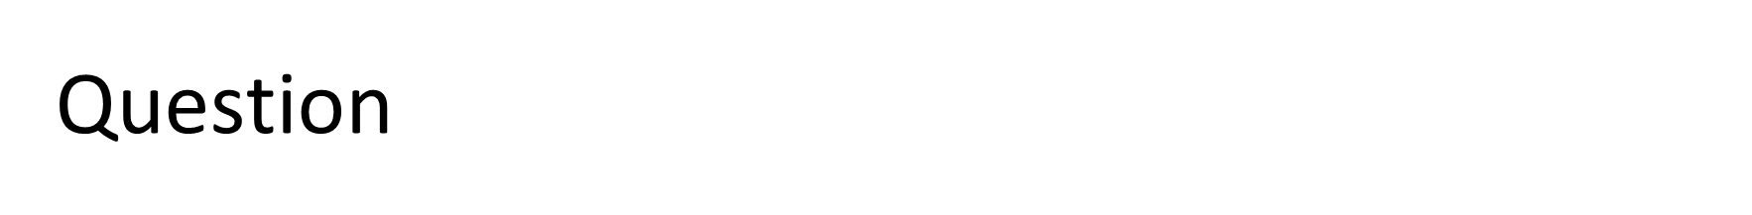
Dean Darren Dahl takes the 393 class on a field trip to Disney"Molan"d, to have some fun before the final. Once they were there, the admissions office, which normally gets all attendees to sign a waiver with an exclusion clause, ran out of paper :(( . As a result, they just let the entire 393 class into the park since there was an exclusion clause on the back of the ticket anyways. It read in bold letters " DisneyMoland" is not responsible for any bodily harm suffered from participating in activities within the park".
There is evidence that Molan, the owner of the park, knew about the frequent breakdowns and dangers of his ride. Yet, he never had his employees tell any attendees.
Questions:
Does the exclusion clause being on the back of a ticket affect its enforceability?
An international student from Wakanda, Tommy, went on one of the rides got severely injured from the entire ride blowing up. There are no theme parks in Wakanda and this is Tommy's first time. Will Tommy be successful in suing Molan's theme park?
Assume that exclusion clauses are binding. Will the ride operators be personally liable?

Slide 6
Question (SGA)
After making $2,000,000 upon selling his company, Nalom went to buy himself an exotic car at Mot’s dealership. After asking Mot which car has the best acceleration, Mot recommended the new Enzo Model. Nalom decided against Mot’s recommendation and decided to purchase a classic Porsche 911 instead. Though disappointed that Nalom did not buy the automobile he recommended, Mot was happy to see his client find a car he liked. Before Nalom left, Mot told him, “It seems you didn’t rely on my professional expertise; but this is a great choice too! The 911 has always been known to have good acceleration!"
After driving the car for a couple of days, Nalom felt he had made a mistake in purchasing the 911. He complained to his friends about the car's engine and the lack of acceleration. Nalom was unsure whether he could return the vehicle.
Can Nalom return the car? Explain the legal basis for your conclusions.

Slide 7
Privity (Question)
Zhang development is building a new apartment in Wesbrook. Zhang development hires a contractor (imperial constructions) to build the apartment. The contractor also contracted the world-famous architect Molan Liu as a subcontractor. Because of Molan's poor work ethic (terrible!), he was unable to get the plan for the building done. The project missed many deadlines and costs were greatly increased by $100k. Zhang development sues Molan but Molan remembers the 393 class he took with Elicia! Molan says to himself: 'heh heh heh, they can't sue me in contract, I'm safe!".
Questions:
Why does Molan think he cannot be sued in contract? Is he right?
Assume that Molan was not a subcontractor and was an employee under the contractor (Imperial Construction). Also, assume that there is a totally legal enforceable exclusion clause that states "Imperial constructions will not be liable for any damages caused by delays in the construction process". Will Zhang dev be able to sue Molan?

Slide 8
Question (Negligence)
Samantha went to a popular restaurant in town to meet her friends for lunch. It was a rainy day, and the restaurant floor was wet. Unfortunately, the restaurant did not have a wet floor sign displayed. As Samantha walked towards the table, she slipped on the wet floor and fell, fracturing her hip. Samantha decides to sue the restaurant for negligence. The restaurant argues that Samantha is partially to blame for not noticing the wet floor.
Assess the legal rights and liabilities of Samantha and the restaurant in this situation.
Does Samantha have a case against the restaurant?
What if Samantha was excitedly running around the restaurant when she slipped?

Slide 9
Question (Negligent Misstatement)
Tommy's Pizzeria hired Molan Liu, a CPA, to prepare a set of financial statements for his pizzeria so that he can evaluate the performance and assets of his business, to determine a value for his business. Tommy was surprised at how good the numbers were and so sold off the business for $3 million to Jimmy. Unfortunately, the reason why numbers were so good was because Molan slept through his 293 and 353 classes, and accidentally inflated the profits and assets of the business by 40%.
Jimmy sues Tommy for falsely inflating the value of his business.
Can Tommy sue Molan?
Can Jimmy sue Molan directly?
Assume that Tommy told Molan that the financial statements will be used by Jimmy to evaluate the value of his pizzeria to buy it in the next month. Can Jimmy sue Molan now?
Assume that Tommy sold Jimmy the business through Tommy Holdings Inc. Tommy owns 100% of the shares. Describe the potential consequences for Tommy if Jimmy sues Tommy holdings.

Slide 10
Question
Taking advantage of governmental stimulus cheques and the overwhelmingly bullish market, managers and executives of Sneakbrokrs decided to launch an IPO during the height of the pandemic. However, because of the market environment and people's general disinterest in sneakers, Sneakbrokrs went bankrupt after a year in operation. Having lost millions of dollars investing in Sneakbrokrs' shares, Sneakbrokrs' shareholders sued Sneakbrokrs for a breach of fiduciary duty.
Does sneakbrokrs have a fiduciary duty to shareholders?
Will the shareholders be successful?

Slide 11
Does sneakbrokrs have a fiduciary duty to shareholders?
Law: Fiduciary Duty test: (Alberta v Elder Advocates of Alberta Society) (fulfill all 3
Establishing a fiduciary duty
To establish whether a fiduciary duty exists, there are three steps as outlined by the SCC in Alberta v Elder Advocates of Alberta Society quoted in Strothers
The professional or fiduciary has undertaken to act in the best interests of the beneficiary
The beneficiary is vulnerable to the fiduciary's control or discretion
An interest (legal or practical) could be harmed by the fiduciary's exercise of discretion or control (has something at risk)
Apply
The professional or fiduciary has undertaken to act in the best interests of the beneficiary
Managers of corporations are legally required to act in the interest of their shareholders
The beneficiary is vulnerable to the fiduciary's control or discretion
Shareholders do not make the day-to-day decisions at companies. They leave all decisions up to the managers, which means the managers exercise decision making power that leaves shareholders vulnerable.
An interest (legal or practical) could be harmed by the fiduciary's exercise of discretion or control (has something at risk)
Yes, shareholders can lose value on their investments
Conclusion: yes, there is a fiduciary duty.

Slide 12
2. Will the shareholders be successful?
Law: Business Judgement rule- this rule assumes that these individuals act in good faith, with due diligence, and in the best interests of the corporation when making business decisions. Even an outcome from a decision was negative for shareholders, as long as directors demonstrate that they acted in the best interests of the corporation, they have not broken the business judgement rule or breached their fiduciary duty
Sneakbrokrs need to show that they have acted 1) honestly and in good faith with a view to the best interests of the company/other party and 2) exercised the care, diligence and skill that a reasonably prudent individual would exercise in comparable circumstances, 3) considered the interests of a range of stakeholders. s long as Sneakbrokrs makes it clear that they have done their due diligence and considered the interests of everyone, they will not be liable.
Application:Sneakbrokrs has shown that they did their due diligence before launching the IPO and considered the shareholders' interests. Judging by the macro-environment at the time, it can be presumed that Sneakbrokrs believed its investors would be able to obtain a healthy rate of return at year's end. However, factors outside of Sneakbrokrs' control (i.e. rate hikes, Fed's hawkishness etc) has prevented Sneakbrokrs from obtaining the resources (sufficient funding etc.) they need; shareholders lost money as a result (students could write this down for clarity; this helps articulate why Sneakbrokrs is not liable and can help reinforce the BJR).
Conclusion: Even though the outcome was negative, Sneakbrokrs made a decision that did not break the business judgement rule and did not breach their fiduciary duty. Thus, they are not liable for the wrongful outcome of the decision. The court will rule against the shareholders in the lawsuit.

Slide 13
Questions (Partnerships)
Beanz, Bunz, and Borz are three friends who decided to start a consulting company called 3B Partnerships. In the agreement, the 3 B's decided to split their profits equally 3 ways, and each will hold a management position in the firm. Borz has been in a medically induced coma for the last four years; during his absence, 3B has been operated on by the other two founding members. No notice of termination was given to Borz during his time in a medically induced coma. After awakening from his coma, Borz discovered that 3 B's has expanded to Vancouver's largest consulting firm with offices across 20 locations. However, Borz was not entitled to any profits as Beanz and Bunz argued that he had not been involved in revenue generation. Dejected upon hearing the news, Borz felt indignant, as he had invested a lot during the early stages of the company. As a result, he decided to sue Beanz and Bunz for ⅓ of the profits 3 B's made over the last four years.
Presuming that no express agreement was made to expel Borz during the time he was in a medically induced coma, would Borz be successful in his lawsuit against the two B’s (Beanz and Bunz)?
Assume that Beanz had been found liable for breaching fiduciary duties and was ordered by the court to compensate his client 40 million dollars. Beanz did not have enough money to pay back the claimant; in this case, could the claimant look to Borz and Bunz to indemnify their losses?

Slide 14
Corporations (Questions)
Molan and Tommy start a Chinese restaurant together to compete with Grand Noodle Emporium and Sesame. They both participate in meetings and contribute 50% of the initial cash to start up the company. They also took out loans from their parents and rich friends at Sauder. Unfortunately, their food tasted so bad that students would often be rushed to the UBC Hospital. They likely won't be able to make payments on their debts because they soon expect their business to go bankrupt
What kind of partners are Molan and Tommy?
What can Molan do if his parents sue him personally?

Slide 15
Corporations
What can Molan do if his parents sue him personally?
Molan can look to Tommy for indemnification because all partners all liable for the actions taken by the other partners on behalf of the business
Even if Molan took out the contract, the contract is binding on all other partners in the GP.

Slide 16
Corporations
Because they took 393, Molan and Tommy remembered that they can simply turn their business into a corporation and can minimize the lawsuits that they anticipate will come (yay, so smart!). Molan and Tommy registered as T&M Inc.
Describe the process that Molan and Tommy took to incorporate
Will they be successful in their incorporation attempt?
Why does Molan and Tommy believe they can minimize their losses through incorporation?

Slide 17
Corporations
Assume that the restaurant is now incorporated and Tommy and Molan are directors. Molan supposedly went looking for new suppliers of ingredients for the restaurant. However, he actually went to the cheapest supplier in town and took a 10% commission on whatever he charged. Tommy found out and sued Molan, will Tommy be successful?

